Slide 1




Slide 2








Slide 3

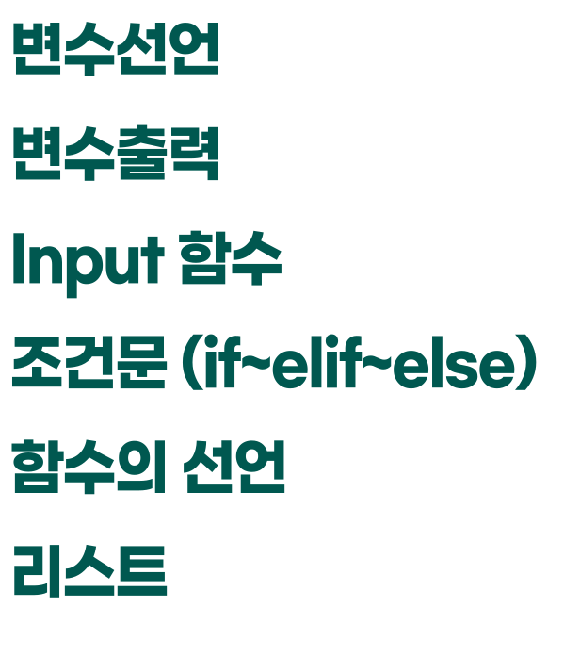



cal=int(input(" 1. 더하기\n 2. 빼기\n 3. 곱하기\n 4. 나누기\n숫자를 입력해주세요:")) print("숫자 두 개를 입력하세요") a=int(input()) b=int(input()) def plus(a,b): result=a+b print(result) def minus(a,b): result=a-b print(result) def mul(a,b): result=a*b print(result) def div(a,b): result=a/b print(result) if cal==1: plus(a,b) elif cal==2: minus(a,b) elif cal==3: mul(a,b) elif cal==4: div(a,b) else: print("1~4중 하나를 입력해주세요")

Slide 4















Slide 5



